Slide 1

Driver Drowsiness Detection
This presentation outlines the development and comparison of Convolutional Neural Network (CNN) and CNN-Recurrent Neural Network (CNN-RNN) models for detecting driver drowsiness.
Presented by Ahmed Bhbaty

Slide 2
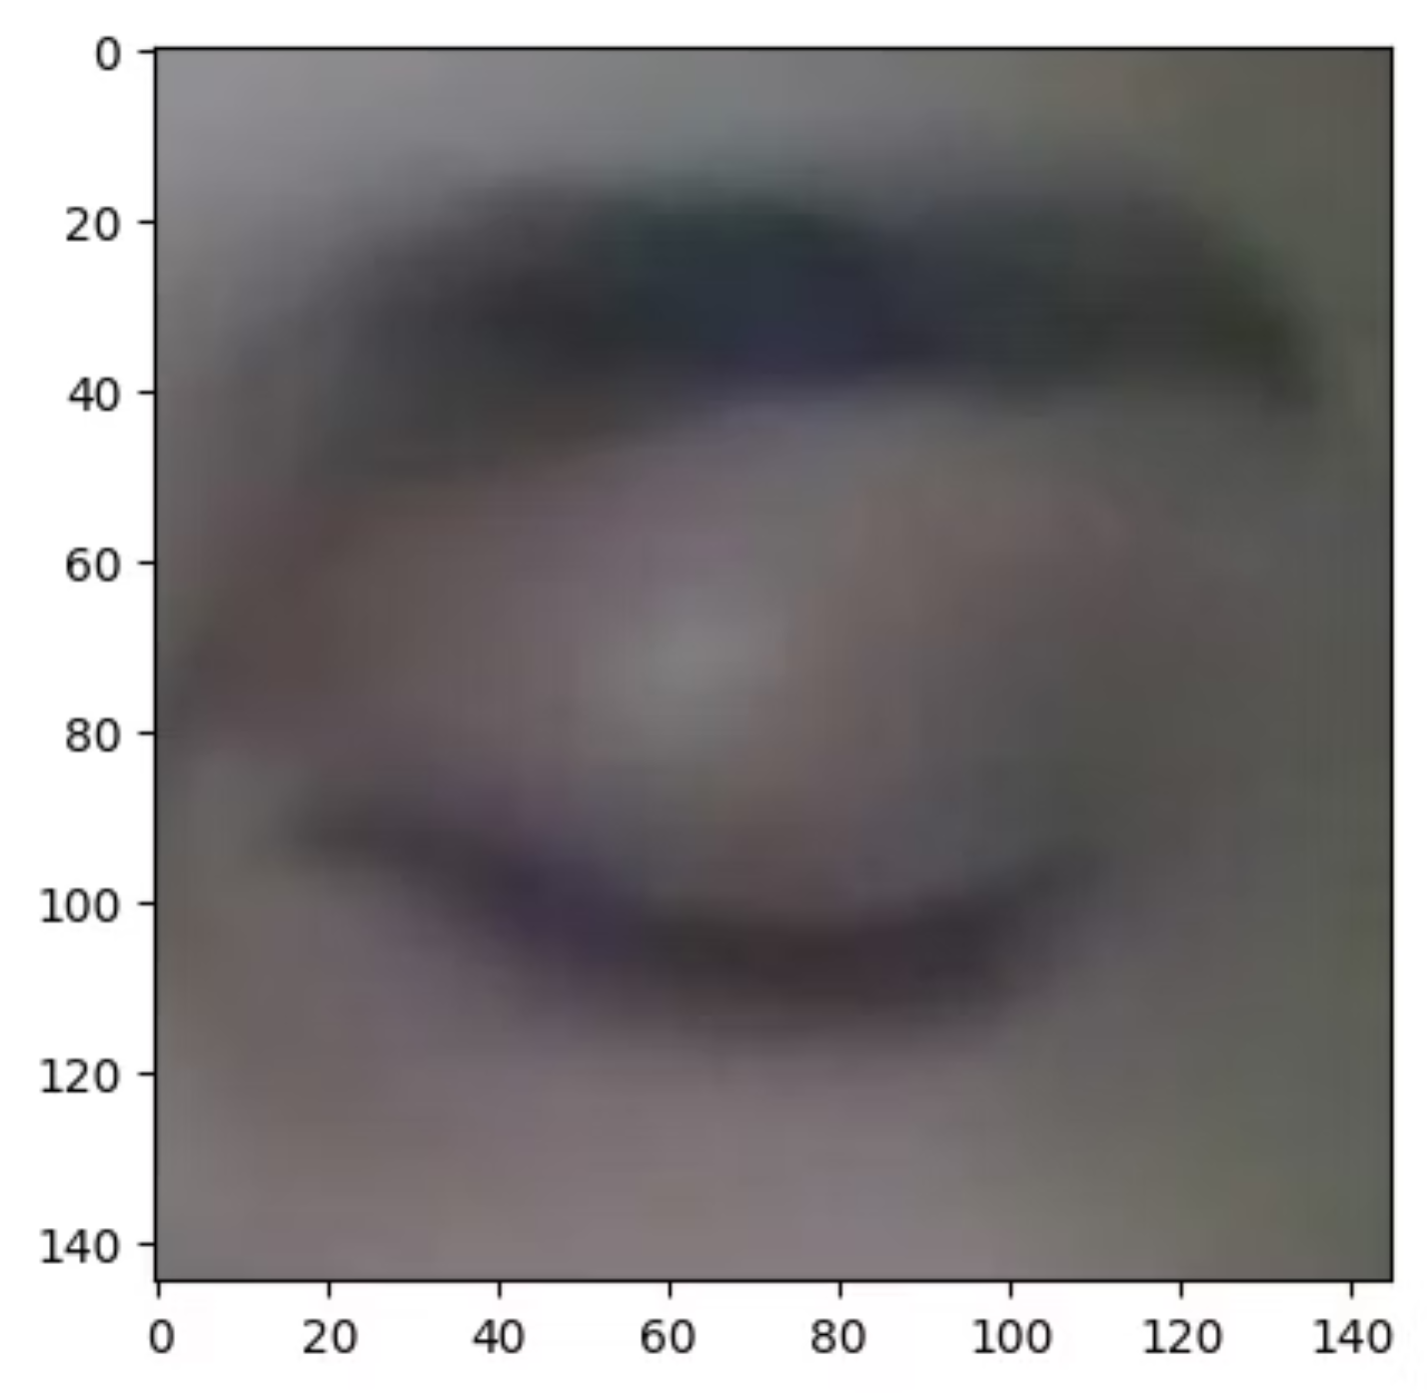

Data Preparation: Initial Steps
The dataset used is from Kaggle (dheerajperumandla/drowsiness-dataset) and contains images categorized into four states:
Closed eyes: 726 images
Open eyes: 726 images
Yawn: 725 images
No_yawn: 723 images
These labels are crucial for training our models to distinguish between alert and drowsy states.

Slide 3
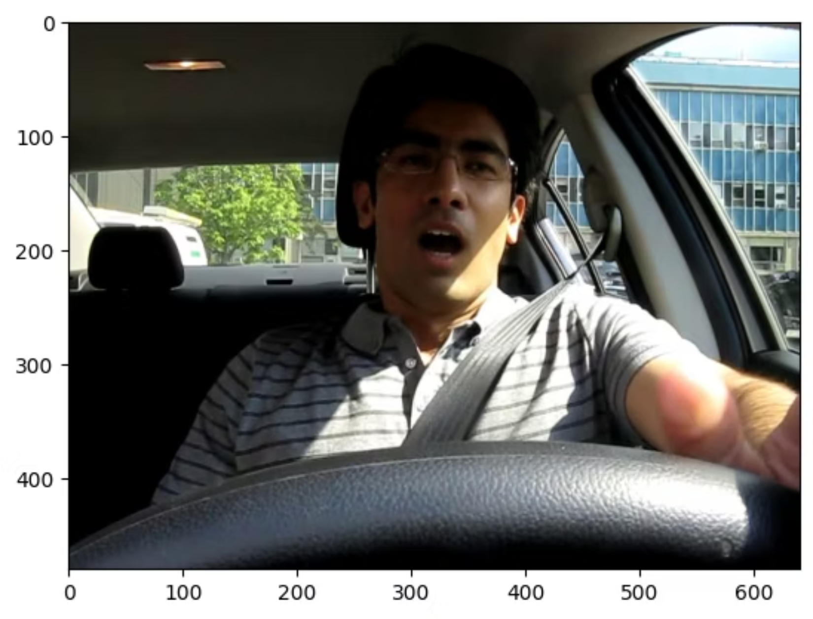
Visualizing the Dataset
To understand the data, we visualize sample images from the dataset. This helps in confirming the correct loading and categorization of images, such as closed eyes and yawning faces.
The images are processed to extract relevant features, ensuring consistency in size and format for model training.

Slide 4
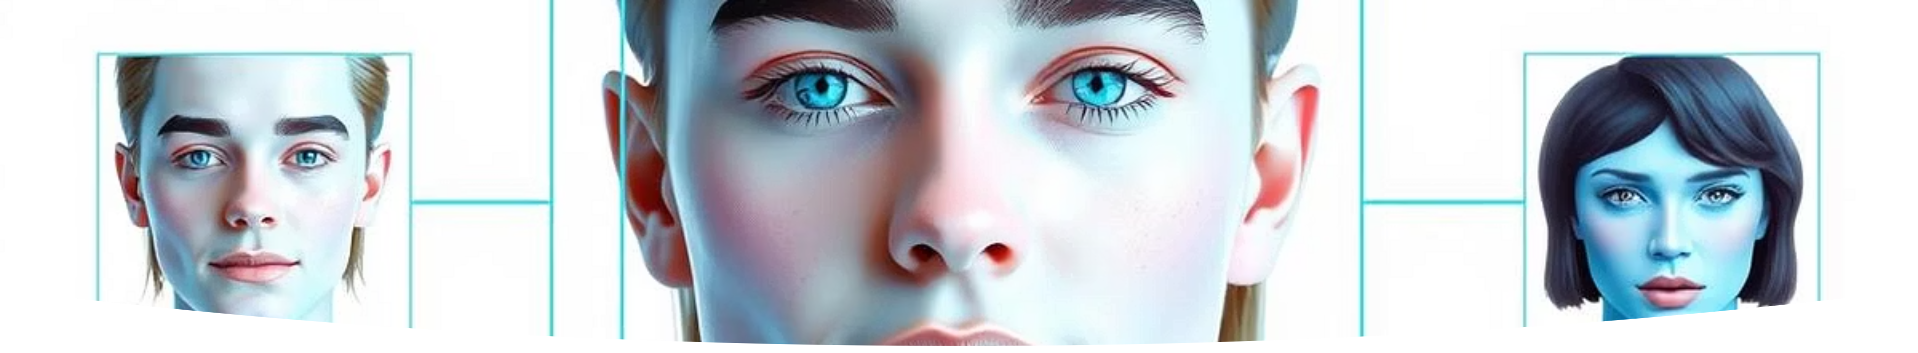


Face Detection and Dat
a Expansion
Face Extraction
Eye State Data
Dataset Consolidation
Utilizing Haar Cascades, we extract only the face regions from both yawn and no-yawn images, focusing the model on critical features.
Similarly, data for open and closed eyes is collected and processed, resizing all images to a uniform 145x145 pixels.
All processed images and their corresponding labels are combined into a single NumPy array, ready for model input.

Slide 5
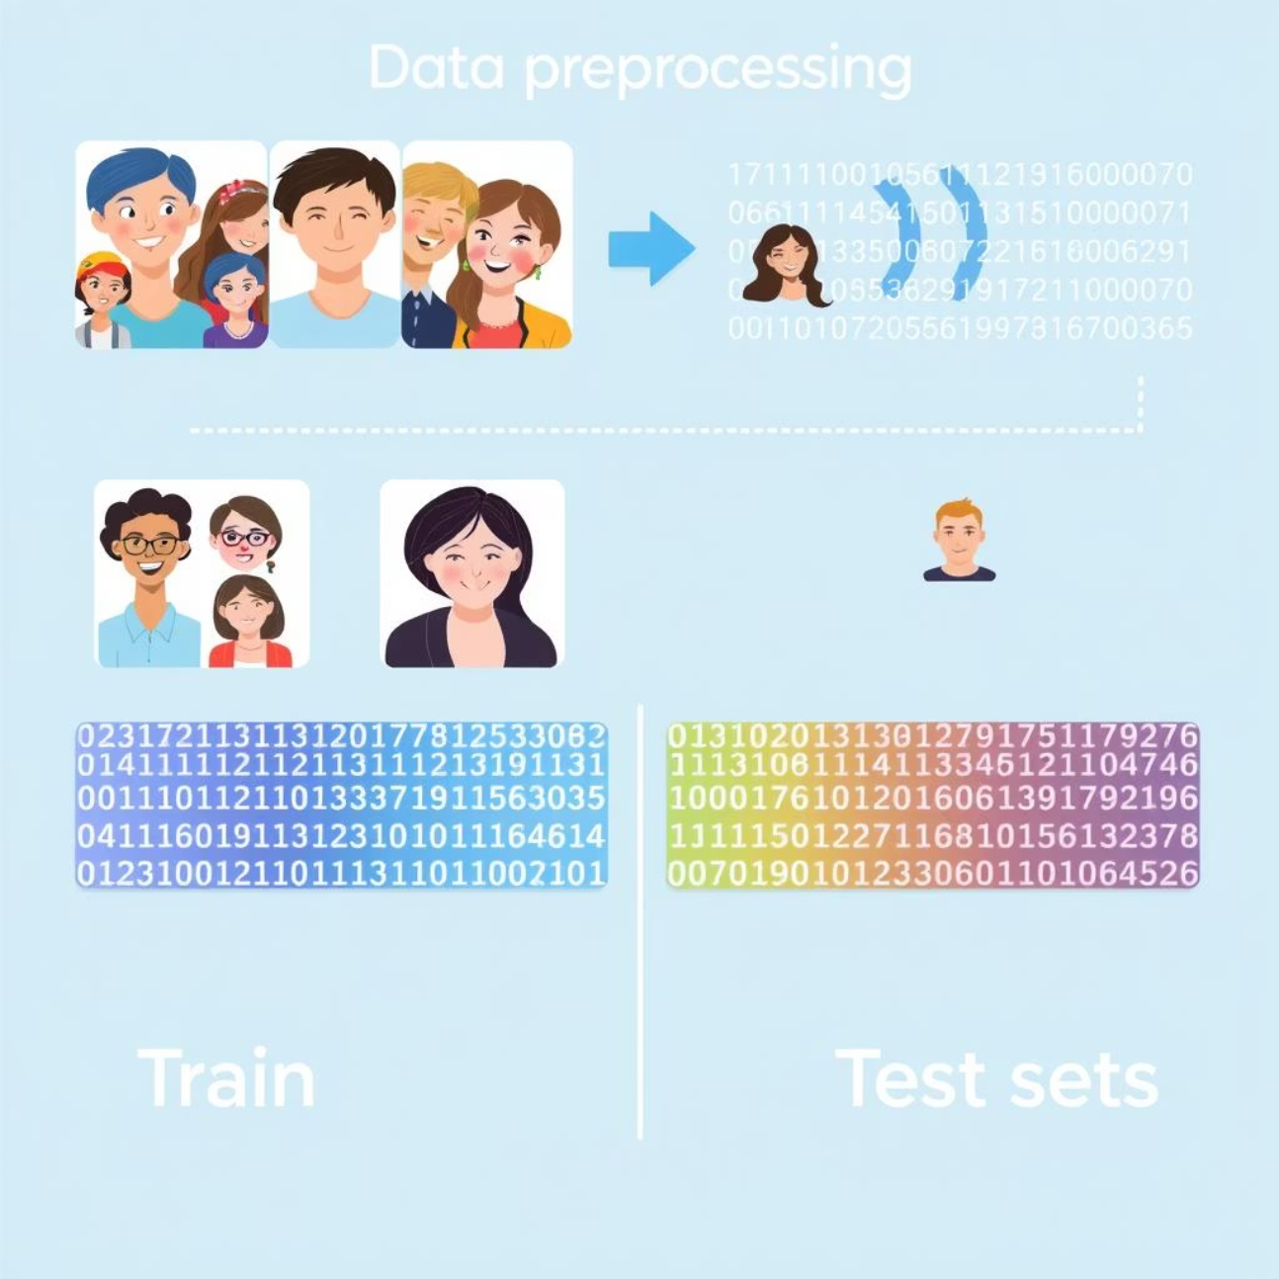
Data Preprocessing for Model Training
The consolidated dataset undergoes further preprocessing:
Images are reshaped to (145, 145, 3) for compatibility with CNN input layers.
The dataset is split into training and testing sets (70% train, 30% test) to evaluate model performance.
Labels are one-hot encoded using to_categorical for multi-class classification.

Slide 6
Methodology: Tools and Technologies
Python
OpenCV
The primary programming language used for data manipulation, model development, and integration of various libraries.
An open-source computer vision library essential for image preprocessing, face detection, and feature extraction.
Keras/TensorFlow
CNN Architecture
Powerful deep learning frameworks leveraged for building, training, and evaluating our neural network models.
Convolutional Neural Network (CNN) architecture, designed for robust pattern recognition and classification of image data.

Slide 7
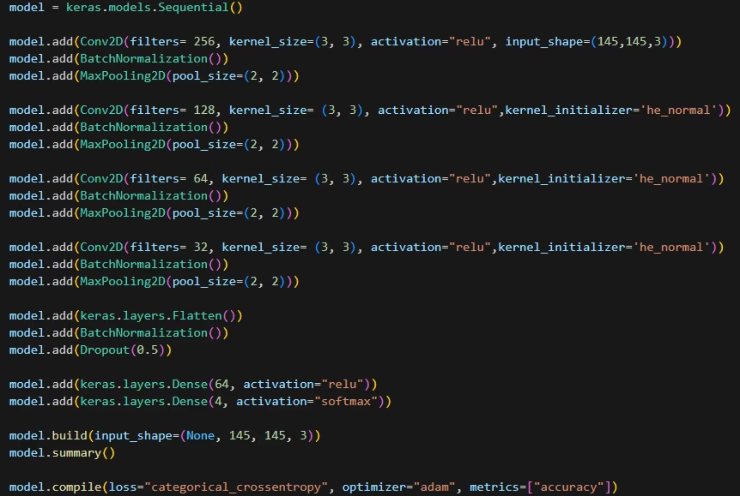
Building the CNN Model
Our model is designed with multiple convolutional layers, batch normalization, and max-pooling layers to extract hierarchical features from the images.
A dropout layer is included to prevent overfitting, followed by dense layers for classification into the four categories.

Slide 8
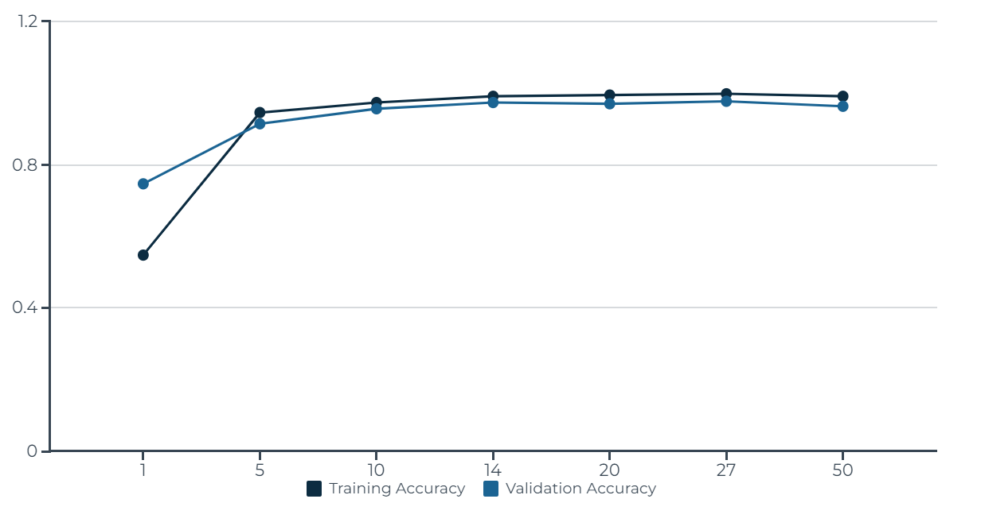
CNN Training and Performance
The CNN model was trained for 50 epochs. It achieved high training and validation accuracy, demonstrating its ability to learn and generalize from the image data. The final model achieved 99.1% training accuracy and 96.1% validation accuracy after 50 epochs.

Slide 9
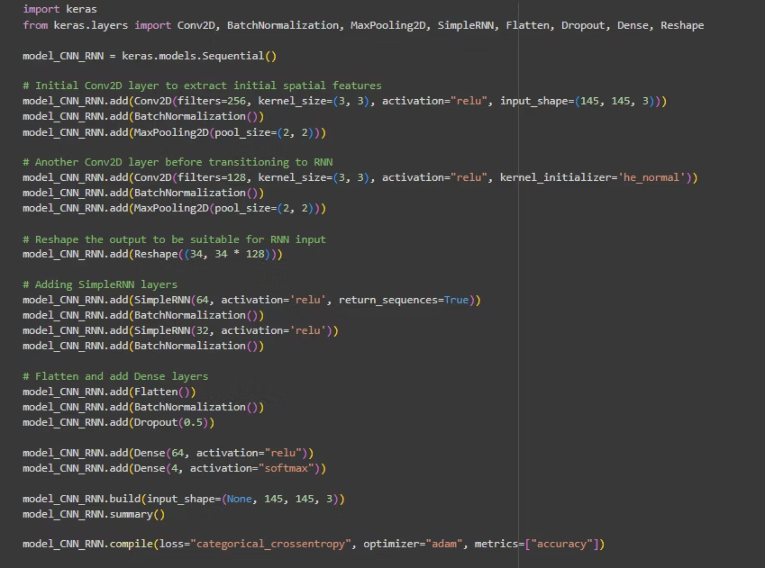
Introducing the CNN-RNN Model
To potentially capture temporal dependencies in drowsiness patterns, we developed a hybrid CNN-RNN model.
This model combines CNN layers for spatial feature extraction with SimpleRNN layers for processing sequential information, aiming for enhanced detection capabilities.

Slide 10
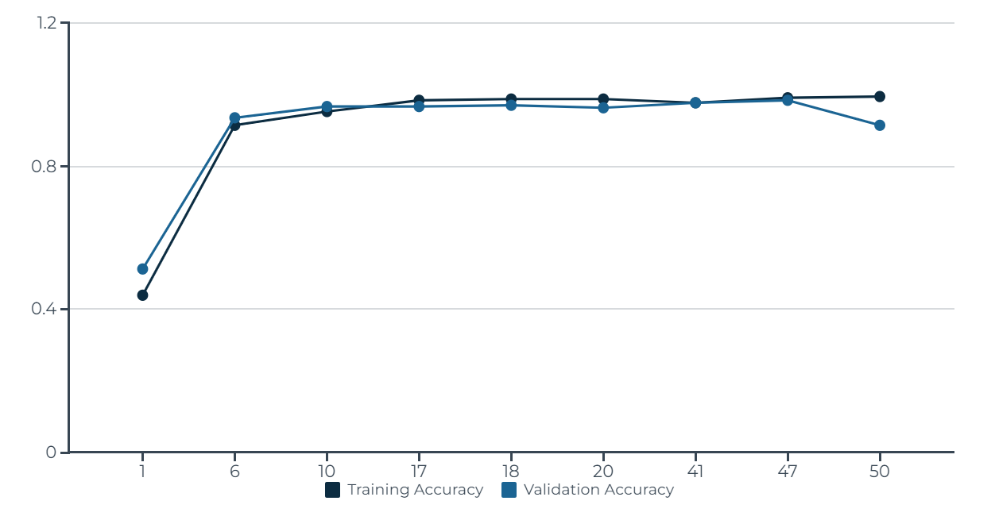
CNN-RNN Model Performance
The CNN-RNN model was also trained for 50 epochs, showing a strong learning curve. It reached a peak validation accuracy of 98.2% by epoch 47, demonstrating its effectiveness in capturing both spatial and temporal features for drowsiness detection. The training accuracy consistently remained high, finishing at 99.4%.

Slide 11
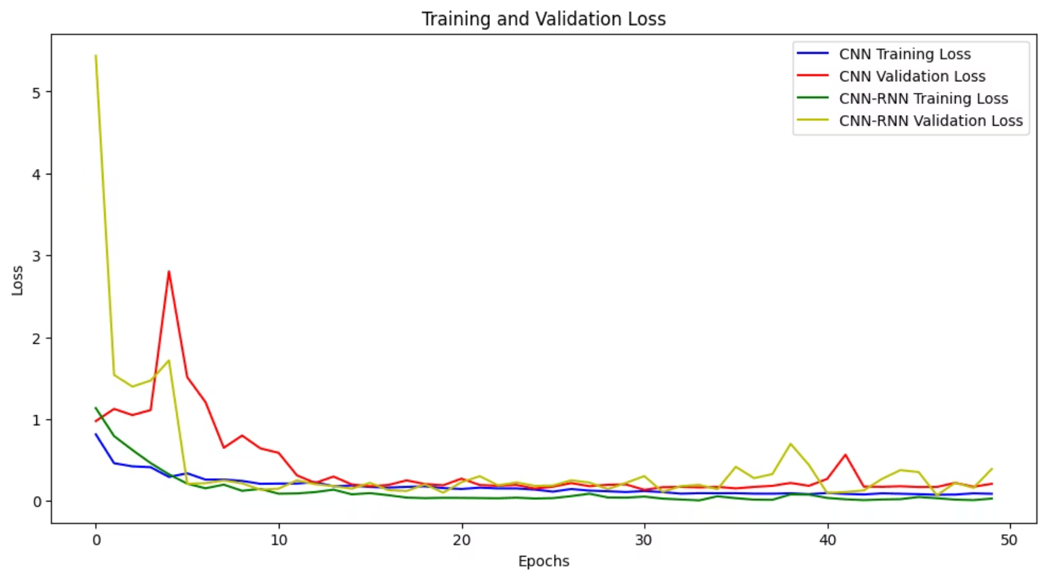
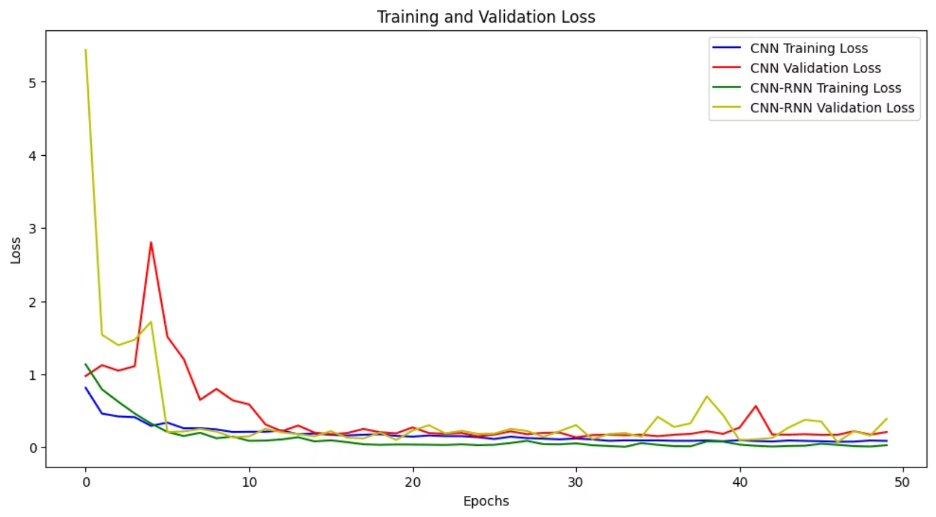
Model Comparison and Evaluation
After comparing the two models, we found that the CNN-RNN model suffers from significant validation loss fluctuations during training, which may indicate difficulty in model stability or generalization issues. This fluctuation requires careful tuning of hyperparameters and regularization techniques to mitigate its impact. In contrast, the CNN model demonstrated more stable performance and better accuracy on the validation data, making it the optimal choice for the current project status.

Slide 12
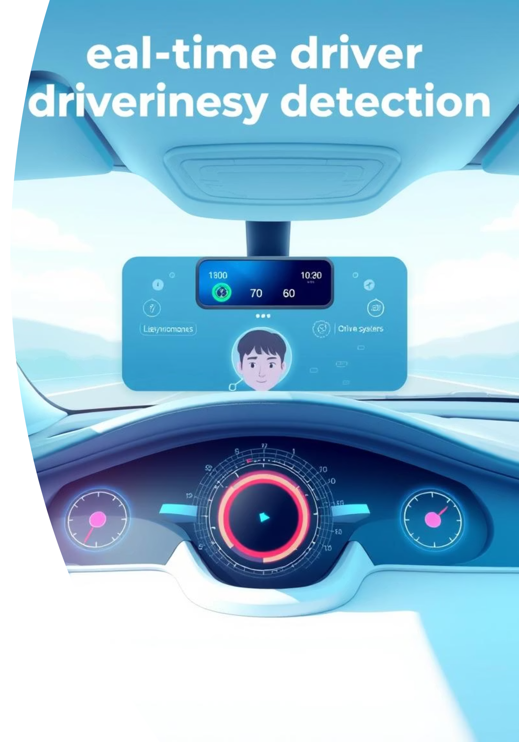


Implementation: Real-Time Detection System
Camera Captures Video Feed
The system continuously captures live video footage of the driver from an in-cabin camera.
Face Detection Using Haar Cascades
Haar Cascades are applied to accurately detect and localize the driver's face within the video frame.
Eye State Classification
The CNN model analyzes the detected face to classify the driver's eye state as open, closed, or other relevant states.
Drowsiness Monitoring (2-Second Threshold)
The system monitors consecutive frames. If closed eyes or yawning persist for more than 2 seconds, drowsiness is confirmed.
Alarm Activation
Upon detecting confirmed drowsiness, an immediate audio and/or visual alarm is activated to alert the driver.

Slide 13
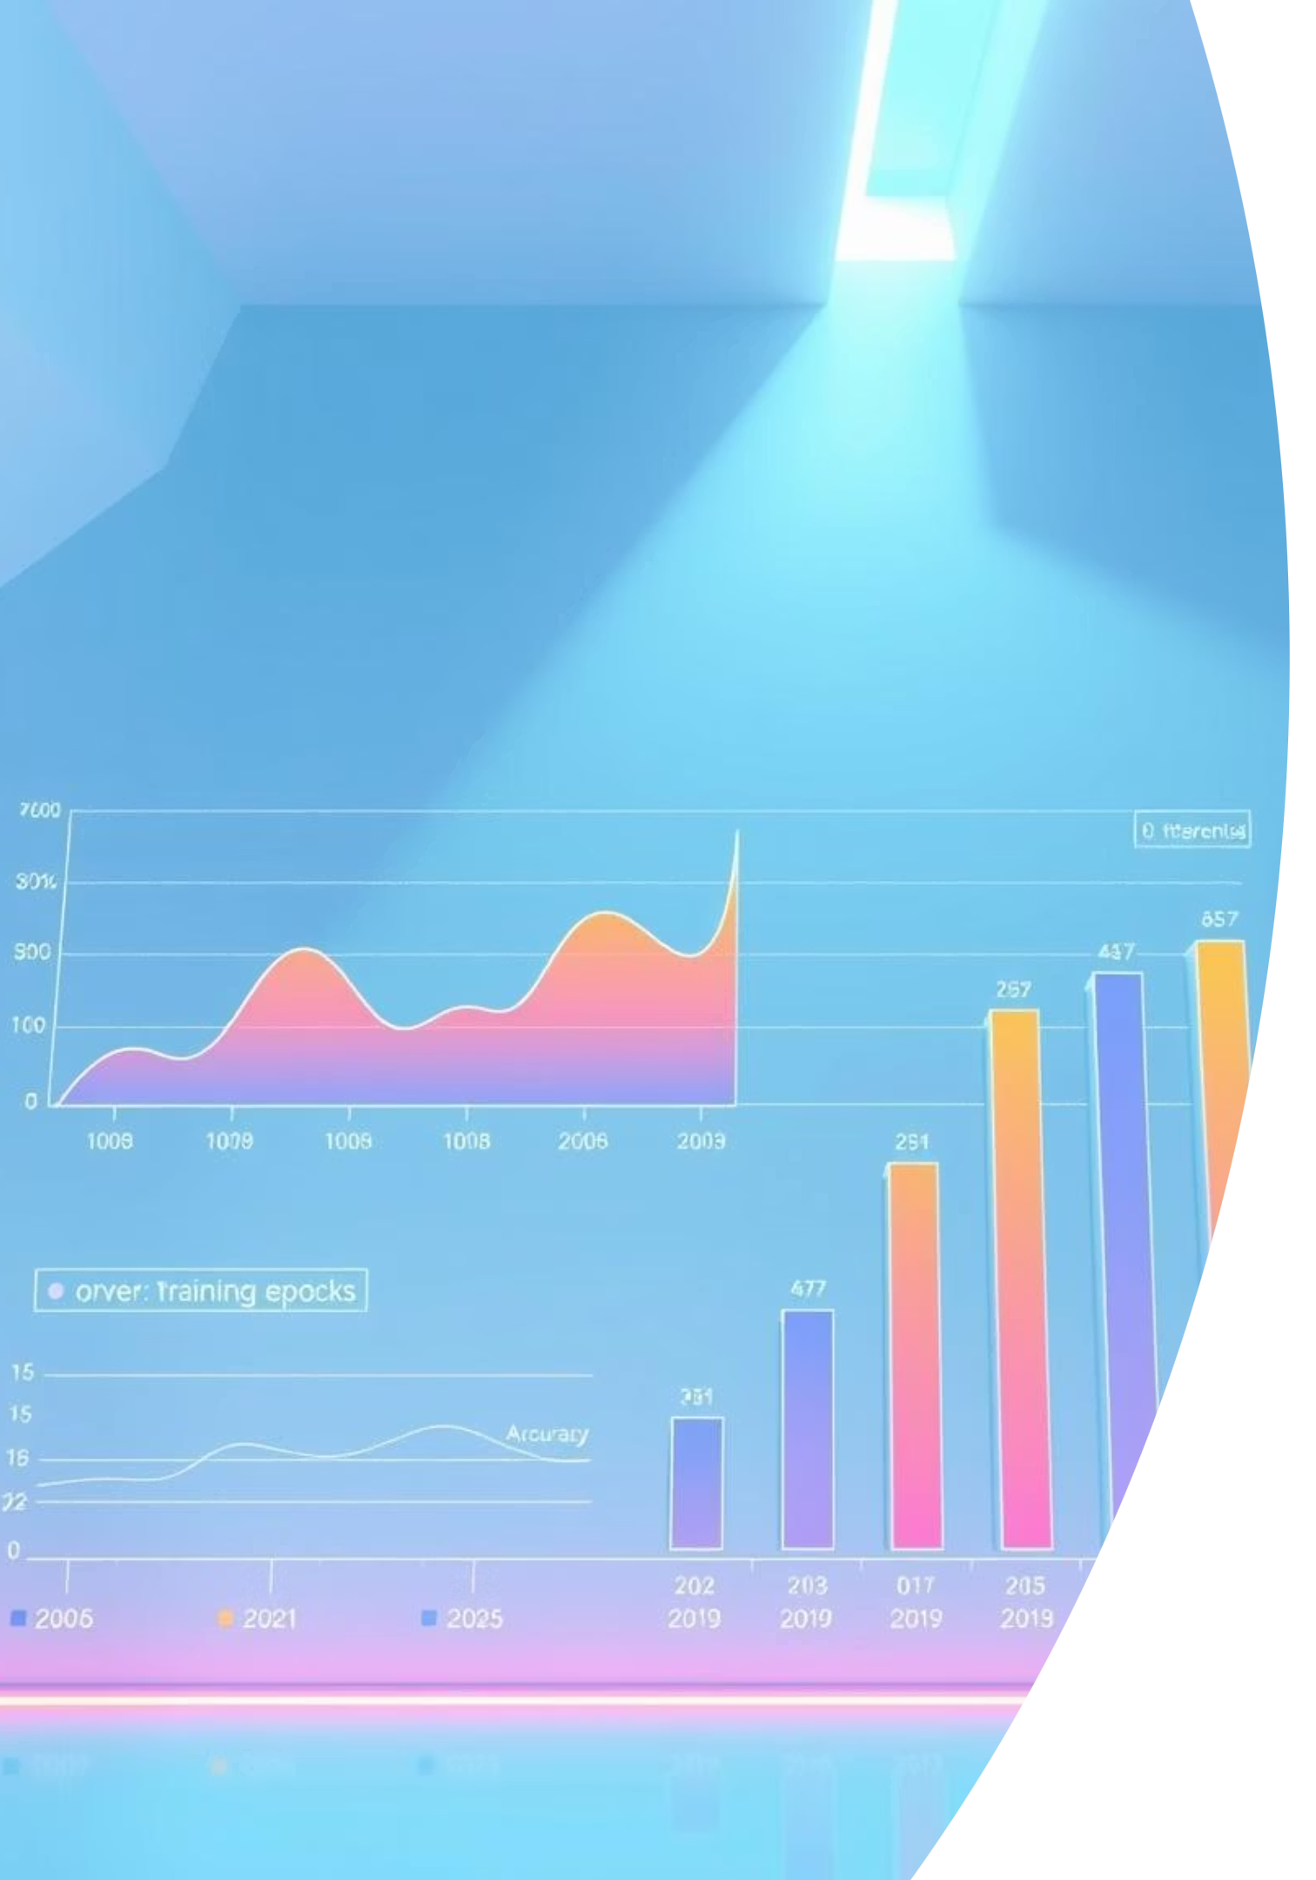
Results: System Performance and Accuracy
98.1%
96.1%
50
Training Accuracy
Validation Accuracy
Epochs Trained
The model achieved a highly precise 98.1% accuracy on the training dataset, indicating effective and thorough learning of features.
Strong performance with 96.1% accuracy on unseen validation data confirms the model's robust ability to generalize and make precise predictions.
The models were trained for 50 epochs, striking a balance between learning and avoiding overfitting.
Overall, the system demonstrated robust performance across key metrics, showcasing its effectiveness in detecting driver drowsiness with high precision and reliability. The chosen models effectively learned from the diverse dataset, yielding promising results for real-world application.

Slide 14

Limitations and Future Directions
Current Limitations
Proposed Future Work
Static Data: Both models primarily rely on static image analysis, which may not fully capture dynamic changes in drowsiness over time.
Real-time Video Analysis: Integrate temporal information more robustly, perhaps with advanced RNN architectures or transformers, for continuous monitoring.
Environmental Factors: Performance might be affected by varying lighting conditions or occlusions (e.g., sunglasses, hands on face).
Multi-modal Fusion: Combine visual cues with physiological data (e.g., heart rate, eye-tracking) for more robust detection.
Individual Variability: Drowsiness signs can differ significantly between individuals, posing a challenge for generalized models.
Adversarial Training: Employ GANs to generate diverse training data, improving model robustness to real-world variability.
Addressing these areas will enhance the practical applicability and reliability of drowsiness detection systems in real-world driving scenarios.

Slide 15
Project Repository and Demo
Explore the full project details, code, and a live demonstration via the links below:
Jupyter Notebook & Code
Deployment
https://git
h
This repository contains all the source code, models, and resources used for the Driver Drowsiness Detection system.
Watch a live demonstration of the real-time drowsiness detection system in action, showcasing its features and effectiveness.

Slide 16

Thank You!
We appreciate your time and interest in our Driver Drowsiness Detection project.

